Slide 1
Machine Exercise 5 – Grocery Detection Miguel Luis Martinez
Uses YOLOv11 fine-tuned on grocery dataset
24 classes, 7604 train + 845 val in total
Train over 500 epochs

Slide 2
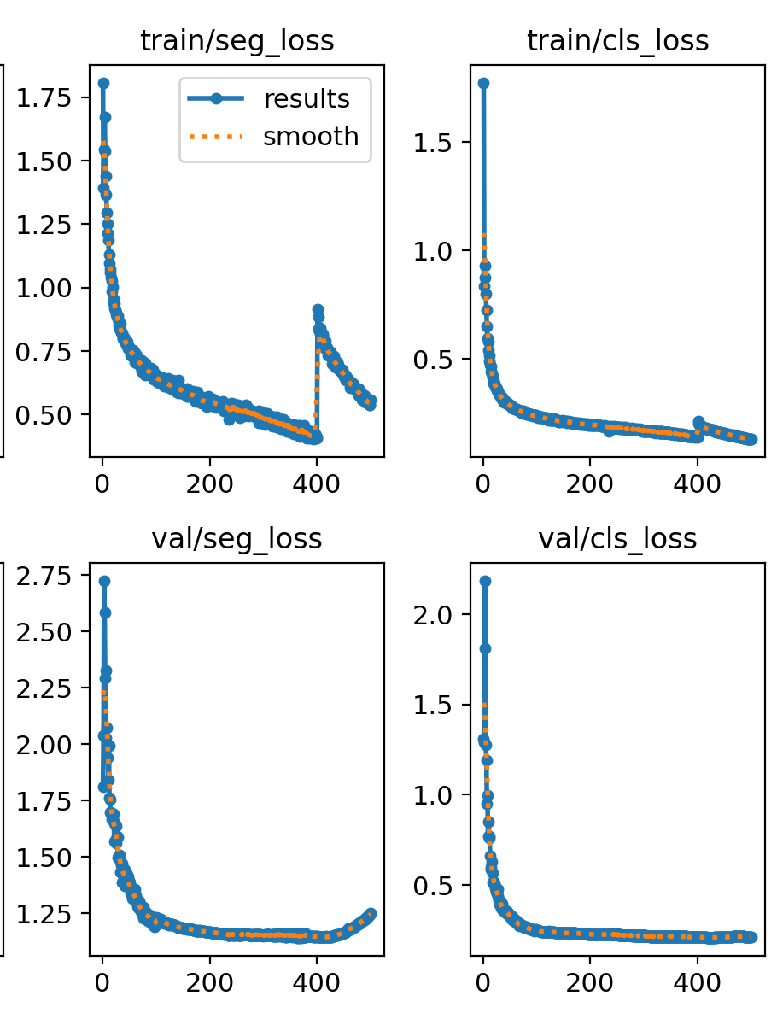
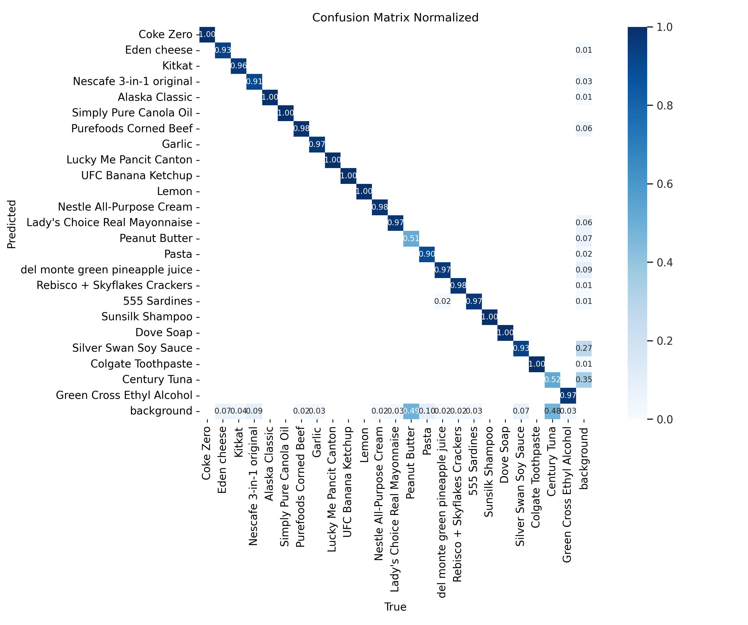
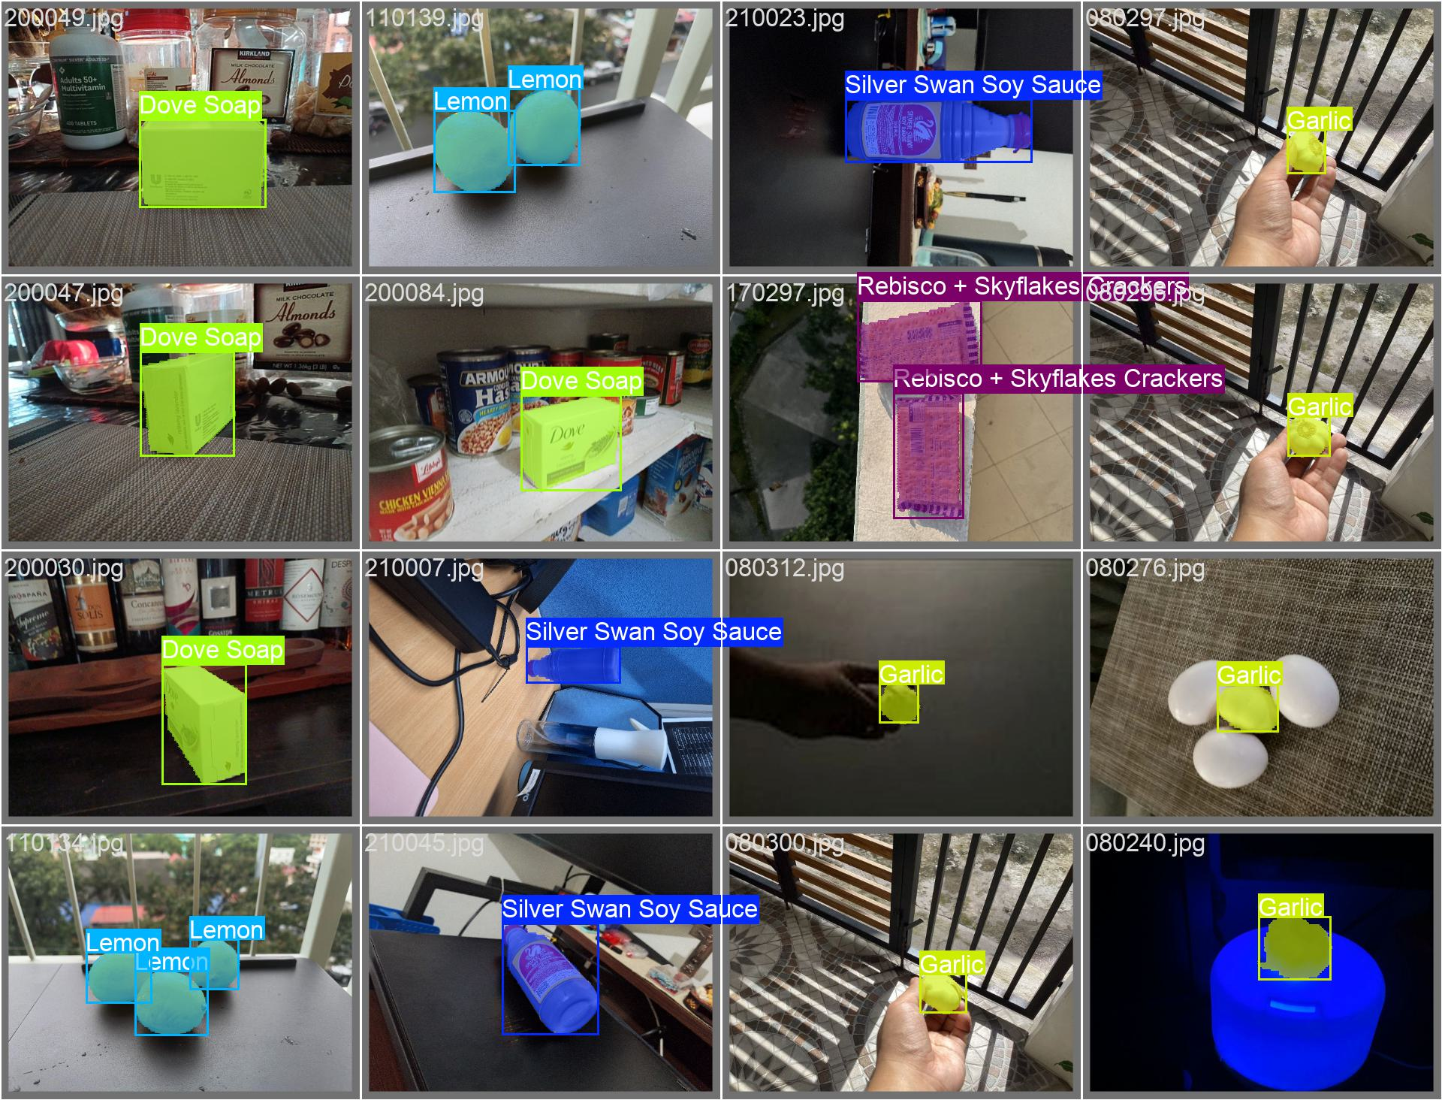
Training Results
Total training time: 90606s
mAP50: 0.9384
mAP50-95:0.8758

Slide 3
Application
Uses streamlit frontend

